Slide 1


Slide 2

Organ transplant
Explained by
Group-6
1.Vijit verma
2.Vatsal verma
3.Utkarsh Yadav
4.Vipul sharma
5.Vipin kumar
6.Vipin gupta
7. Vedang Tiwari
8.Vishwas jaiswal

Slide 3
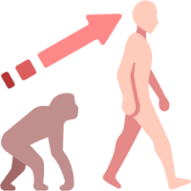
History of organ transplantation
First kidney transplant 1954
First heart and pancreas transplant 1960s
Lung and intestial transplant 1980s

Slide 4
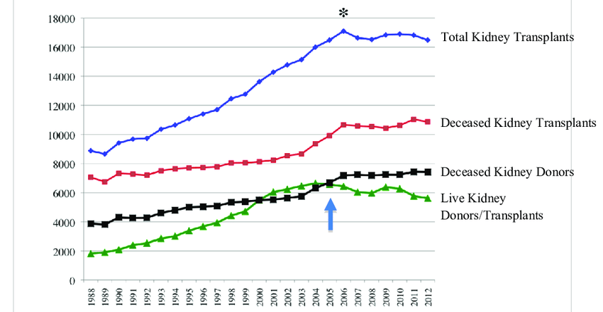
Graphical trend of organ transplantation

Slide 5
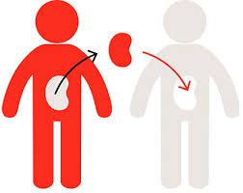
Age limit for organ donation
Kidney and lever upto 70 yrs
Heart and lung upto 50 yrs
Pancreas intestines upto 60-65yrs
Corneas skin upto 100 yrs
Heart walves upto 50yrs
Bones upto 70yrs

Slide 6

NOTTO (national organ and tissue transplant organization
You can be a donor by expressing your wish in the authorized organ and tissue donation as per organized by notto

Slide 7

Medication after the transplant
Immunosuppressant : drugs prevent your immune system for rejecting the donor organ
They must be taken for the lifetime of your transplanted organ

Slide 8

After transplant, its vital for us to
Keep all your doctor appointment
Undergoes every recommended lab test
Take all the prescription drugs
Keep all wellness checkups
Monitors you blood weight and cholesterol
Get all recommended health screenings on schedule

Slide 9
Indias organ crisis deepens
Poor training of doctors and misgivings among people trigger enormous shortage ,liver ,heart and cornea
Major problems are unlike blood transfusion ,major surgery failure the intensive use of immunosuppressants ,transplant rejection etc

Slide 10

Disadvantages of organ transplant
Pain
Infection
Hernia
Bleeding’
Blood clots
Wound complication
Unfortunately death in rare cases

